Slide 1

স্বাগতম
WELCOME

Slide 2
SHAKTI PRASAD GANGULY
INSTRUCTOR (ELECTRICAL)
JESSORE POLYTECHNIC INSTITUTE

Slide 3
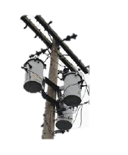
এসি মেসিন-১ (বিষয় কোড-৬৬৭৬1 ) UªvÝdigvi : 8g Aa¨vq
AUTO-TRANSFORMER
8. Introduction . (f‚wgKv)
8.1 Describe the Auto-Transformer :
8.2 Explanation of The Terms Transformer
Power and Conducted Power :
8.3 Advantages and Disadvantage Auto-Txr.
JESSORE POLYTECHNIC INSTITUTE

Slide 4
এসি মেসিন-১ (বিষয় কোড-৬৬৭৬1 ) UªvÝdigvi : 8g Aa¨vq
AUTO-TRANSFORMER
8.4 Convert a Two-Winding Convensional Txr. To Auto-Txr.
8.5 Uses of Auto-Transformer :
8.6 Solve of Problems Auto-Transformer :
JESSORE POLYTECHNIC INSTITUTE

Slide 5
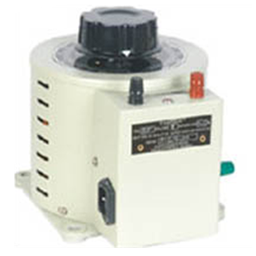
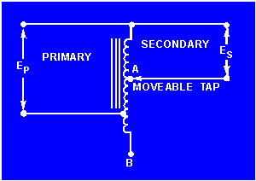
AUTO-TRANSFORMER
8.1
একটি Autotransformer এর ছকবদ্ধ চিত্রটি.
JESSORE POLYTECHNIC INSTITUTE

Slide 6
এসি মেসিন-১ (বিষয় কোড-৬৬৭৬1 ) UªvÝdigvi : 8g Aa¨vq
8. Introduction .(f‚wgKv )
UªvÝdigv‡ii
JESSORE POLYTECHNIC INSTITUTE

Slide 7
এসি মেসিন-১ (বিষয় কোড-৬৬৭৬1 ) UªvÝdigvi : 8g Aa¨vq
8.1 Describe the AutoTransformer :
An autotransformer is a kind of electrical transformer where primary and secondary shares same common single winding. So basically it’s a one winding transformer.
Autotransformer Theory
In an auto transformer, one single winding is used as primary winding as well as secondary winding. But in two windings transformer two different windings are used for primary and secondary purpose. A circuit diagram of auto transformer is shown below.
JESSORE POLYTECHNIC INSTITUTE

Slide 8
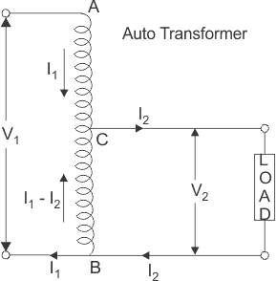
এসি মেসিন-১ (বিষয় কোড-৬৬৭৬1 ) UªvÝdigvi : 8g Aa¨vq
The winding AB of total turns N₁ is considered as primary winding. This winding is tapped from point ′C′ and the portion BC is considered as secondary. Let’s assume the number of turns in between points ′B′ and ′C′ is N₂.
If V₁ voltage is applied across the winding i.e. in between ′A′ and ′C′.
JESSORE POLYTECHNIC INSTITUTE

Slide 9

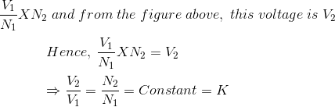
Hence, the voltage across the portion BC of the winding, will be,
As BC portion of the winding is considered as secondary, it can easily be understood that value of constant ′k′ is nothing but turns ratio or voltage ratio of that auto transformer. When load is connected between secondary terminals i.e.between ′B′ and ′C′, load current I₂ starts flowing. The current in the secondary winding or common winding is the difference of I₂ and I₁.

Slide 10
এসি মেসিন-১ (বিষয় কোড-৬৬৭৬1 ) UªvÝdigvi : 8g Aa¨vq
8.2 Explanation of The Terms Transformer Power and Conducted Power :
JESSORE POLYTECHNIC INSTITUTE

Slide 11
এসি মেসিন-১ (বিষয় কোড-৬৬৭৬1 ) UªvÝdigvi : 8g Aa¨vq
8.3 Advantages and Disadvantage Auto-Txr.
Advantages of using Auto Transformers
For transformation ratio = 2, the size of the auto transformer would be approximately 50% of the corresponding size of two winding transformer. For transformation ratio say 20 however the size would be 95 %. The saving in cost of the material is of course not in the same proportion. The saving of cost is appreciable when the ratio of transformer is low, that is lower than 2. Thus auto transformer is smaller in size and cheaper.
An auto transformer has higher efficiency than two winding transformer. This is because of less ohmic loss and core loss due to reduction of transformer material.
Auto transformer has better voltage regulation as voltage drop in resistance and reactance of the single winding is less.
JESSORE POLYTECHNIC INSTITUTE

Slide 12
Disadvantages of Using Auto Transformer
Because of electrical conductivity of the primary and secondary windings the lower voltage circuit is liable to be impressed upon by higher voltage. To avoid breakdown in the lower voltage circuit, it becomes necessary to design the low voltage circuit to withstand higher voltage.
The leakage flux between the primary and secondary windings is small and hence the impedance is low. This results into severer short circuit currents under fault conditions.
The connections on primary and secondary sides have necessarily needs to be same, except when using interconnected starring connections. This introduces complications due to changing primary and secondary phase angle particularly in the case of delta/delta connection.
Because of common neutral in a star/star connected auto transformer it is not possible to earth neutral of one side only. Both their sides should have their neutrality either earth or isolated.
It is more difficult to maintain the electromagnetic balance of the winding when voltage adjustment tappings are provided. It should be known that the provision of tapping on an auto transformer increases considerably the frame size of the transformer. If the range of tapping is very large, the advantages gained in initial cost is lost to a great event.

Slide 13
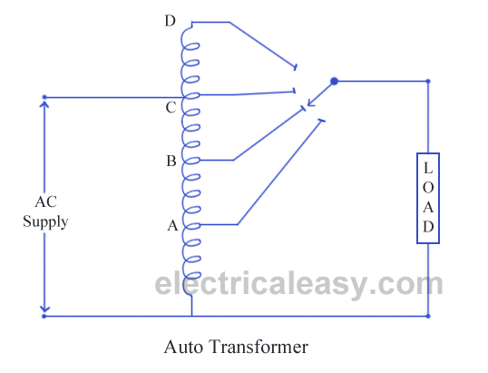
অটো ট্রান্সফরমার নির্মাণ

Slide 14

এসি মেসিন-১ (বিষয় কোড-৬৬৭৬1 ) UªvÝdigvi : 8g Aa¨vq
8.4 Convert a Two-Winding Convensional Txr. To Auto-Txr.
JESSORE POLYTECHNIC INSTITUTE

Slide 15
এসি মেসিন-১ (বিষয় কোড-৬৬৭৬1 ) UªvÝdigvi : 8g Aa¨vq
8.5 Uses of Auto-Transformer :
Applications of Auto Transformers
Compensating voltage drops by boosting supply voltage in distribution systems.
Auto transformers with a number of tapping are used for starting induction and synchronous motors.
Auto transformer is used as variac in laboratory or where continuous variable over broad ranges are required.
JESSORE POLYTECHNIC INSTITUTE

Slide 16
এসি মেসিন-১ (বিষয় কোড-৬৬৭৬1 ) UªvÝdigvi : 8g Aa¨vq
8.6 Solve of Problems Auto-Transformer :
JESSORE POLYTECHNIC INSTITUTE

Slide 17
Auto transformers

Slide 18
Auto transformers (continue)
Auto transformers are a special type, since they have no electrical isolation between the primary and secondary windings. A single continuous winding is wound on a laminated iron core, where part of the winding is used as the primary, whilst the other part is used as the secondary, as shown below.

Slide 19
Auto transformers (continue)
These transformers can be used to either step-up or step-down the applied voltage, depending on the winding configuration.

Slide 20
Auto transformers (continue)
In a step-down device, the whole of the winding serves as the primary winding, whilst the lower half of the winding serves as the secondary winding. In this case, there are fewer turns in the secondary than in the primary: so the voltage is stepped-down, but the current is stepped-up. This configuration is typically used to power aircraft instruments where the voltage is stepped down from 115 V 400 Hz to 26 VAC.

Slide 21
Auto transformers (continue)
The disadvantage of this format is that the full voltage is placed across the load if the coil goes open circuit, since there is no voltage isolation between the two windings.

Slide 22
Auto transformers (continue)
Conversely, in a step-up auto transformer, the lower half of the coil is used as the primary, and the entire coil is used as the secondary. In this case, the secondary has more turns than the primary, so the transformer steps-up the voltage and steps-down the current. On aircraft, this arrangement is typically used in windshield anti-icing systems.

Slide 23
Auto transformers (continue)
Conversely, in a step-up auto transformer, the lower half of the coil is used as the primary, and the entire coil is used as the secondary. In this case, the secondary has more turns than the primary, so the transformer steps-up the voltage and steps-down the current. On aircraft, this arrangement is typically used in windshield anti-icing systems.

Slide 24
Auto transformers (continue)
If the output from the auto transformer can be varied via a moveable tapping, as shown below, it is also known as a variac and is typically used on the flight deck to control the intensity of ultra-violet lighting.

Slide 25
Auto transformers
Auto transformer is kind of electrical transformer where primary and secondary shares same common single winding.
Theory of Auto Transformer

Slide 26
Auto transformers
In Auto Transformer, one single winding is used as primary winding as well as secondary winding. But in two windings transformer two different windings are used for primary and secondary purpose. A diagram of auto transformer is shown below.

Slide 27

Auto transformers
The winding AB of total turns N₁ is considered as primary winding. This winding is tapped from point ′C′ and the portion BC is considered as secondary. Let’s assume the number of turns in between points ′B′ and ′C′ is N₂. If V₁ voltage is applied across the winding i.e. in between ′A′ and ′C′.

Slide 28

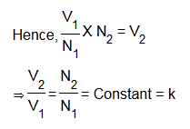
Hence, the voltage across the portion BC of the winding, will be,
As BC portion of the winding is considered as secondary, it can easily be understood that value of constant ′k′ is nothing but turns ratio or voltage ratio of that auto transformer.
When load is connected between secondary terminals i.e.between ′B′ and ′C′, load current I₂starts flowing. The current in the secondary winding or common winding is the difference of I₂ & I₁.

Slide 29
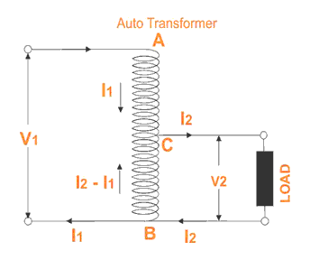
Auto transformers

Slide 30
Copper Savings in Auto Transformer
Now we will discuss the savings of copper in auto transformer compared to conventional two winding transformer.
We know that weight of copper of any winding depends upon its length and cross – sectional area..

Slide 31
Copper Savings in Auto Transformer
Again length of conductor in winding is proportional to its number of turns and cross – sectional area varies with rated current.
Therefore, weight of copper in the section AC proportional to,

Slide 32
Copper Savings in Auto Transformer
So weight of copper in winding is directly proportional to product of number of turns and ratedcurrent of the winding.
Therefore, weight of copper in the section AC proportional to,

Slide 33

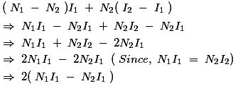
and similarly, weight of copper in the section BC proportional to,
Hence, total weight of copper in the winding of auto transformer proportional to,

Slide 34
In similar way it can be proved, the weight of copper in two winding transformer is proportional to,
N₁I₁ + N₂I₂
⇒ 2N₁I₁ (Since, in a transformer N₁I₁ = N₂I₂)
Let’s assume, W_{a} and W_{tw} are weight of copper in auto transformer and two winding transformer respectively,

Slide 35
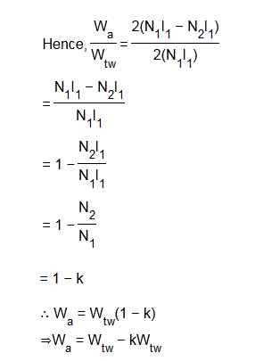
Auto transformers
∴ Saving of copper in auto transformer compared to two winding transformer,

Slide 36
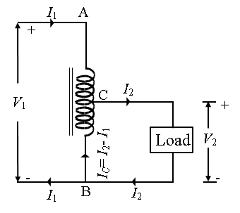
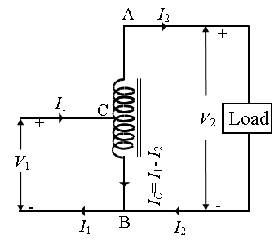
Auto-Transformer
The transformer with one winding only, part of this being common to both primary and secondary, is called auto transformer.
In this transformer the primary and secondary are not electrically isolated from each other as is the case with a 2-winding transformer.
But its theory and operation are similar to those of a two winding transformer.
Because of one winding, it uses less copper and hence is cheaper.
Fig. 32.60 shows both step-down and step-up auto- transformer.
Fig. 32.60 (a)
Fig. 32.60 (b)

Slide 37
As shown in Fig. 30.60(a), AB is primary winding having N₁ turns and BC is secondary winding having N₂ turns.
Neglecting iron losses and no-load current:
The current in section CB is vector difference of I₂ and I₁.
But as the two currents are practically in phase opposition, the resultant current is (I₂-I₁) where I₂ is greater than I₁.
As compared to an ordinary 2-winding transformer of same output, an auto-transformer has higher efficiency but smaller size.
Moreover, its voltage regulation is also superior.
Fig. 32.60 (a)
Fig. 32.60 (b)

Slide 38
Saving of Copper
Volume and hence weight of Cu, is proportional to the length and area of cross-section of the conductors.
Length of conductor is proportional to the number of turns and cross section depends on current.
Hence, weight is proportional to the product of the current and number of turns.
With reference to Fig. 32.60
Weight of Cu in section AC∝(N₁- N₂)I₁;
Weight of Cu in section BC∝(I₂- I₁)N₂;
So, total weight of Cu in auto-transformer (W_{a}) ∝(N₁- N₂)I₁+(I₂- I₁)N₂;
If a two winding transformer were to perform the same duty, then
Weight of Cu in primary∝N₁I₁;
Weight of Cu in secondary∝N₂I₂;
Total weight of Cu (W_{o}) ∝N₁I₁+N₂I₂;

Slide 39
Hence, saving will increase as K approaches unity.
It can be proved that power transform inductively is= input(1-K)
The rest of the power= (K×input) is conducted directly from the source to the load i.e. it is transferred conductively to the load.

Slide 40
Uses of Auto-Transformer
Auto transformers are used:
1. To give small boost to a distribution cable for the voltage drop.
2. As auto-starter transformers to give up to 50 to 60% of full voltage to an induction motor during starting.
3. As furnace transformers for getting a convenient supply to suit the furnace winding from a 230 V supply.
4. As interconnecting transformer in 132 kV/330 kV system.
5. In control equipment for 1-phase and 3-phase electrical locomotives.

Slide 41
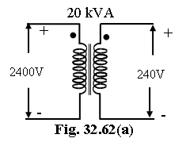
Conversion of 2-winding Transformer into Auto-Transformer
Any two-winding transformer can be converted into an auto-transformer either step-down or step-up. Fig. 32.62(a) shows such a transformer with its polarity marking.
If we employ additive polarity between the high-voltage and low-voltage sides, we get a step-up transformer.
If, however, we use the subtractive polarity, we get a step-down auto-transformer.

Slide 42
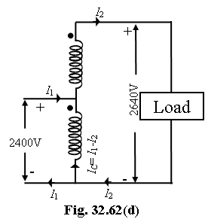
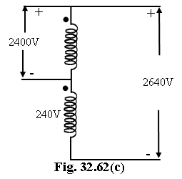
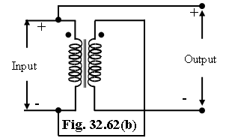
Additive Polarity
Connections for such a polarity are shown in Fig. 32.62(b).
The circuit is re-drawn in Fig. 32.62(c) showing common terminal at the bottom.
Because of additive polarity, V₂=2400+240=2640 V and V₁ is 2400 V.
As shown in Fig. 32.62(d), common current flows towards the common terminal. The transformer acts as a step-up transformer.

Slide 43


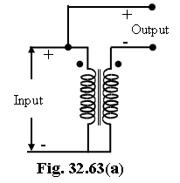
Subtracting Polarity
Such a connection is shown in Fig. 32.63(a).
The circuit has been re-drawn with common polarity at top in Fig. 32.63(b) and in Fig. 32.63(c).
In this case, the transformer acts as a step-down auto-transformer.
The common current flows away from the common terminal.
Here V₂= 2400-240= 2160 V.

Slide 44
পরিচিতি
শক্তি প্রসাদ গাঙ্গুলী
বি এস সি ইন টেক এডু(ইইই)
বিসিএস(কারিগরি শিক্ষা)
ইন্সট্রাক্টর(ইলেকঃ)
যশোর পলিটেকনিক ইন্সটিটিউট
যোগদান তারিখঃ ১১/১০/১৯৮৮ইং
জন্ম তারিখঃ ১০/০৮/১৯৬১ইং
Email : spg_et@yahoo.com

